Slide 1
VEHICLE TO VEHICLE SAFETY SYSTEM-AN EASE FOR SAFE DRIVING
Presented By
T.RAGHAVENDRA

Slide 2
IT CONTAINS
Introduction
Components
Software's Used
Necessity of technology
Design
Functionality
Purpose
Advantages
Applications
Conclusions
Future Scope

Slide 3
INTRODUCTION
Technology achieves success only when it meets every stratum of people.
This project introduces a first of its kind vehicle tracking system that works only using GSM and GPS.
It would be the cheapest source of vehicle tracking anti theft system.
It is a small kit that consists of GSM module, GPS module and several other components.
The microcontroller which is connected to the vibration sensor which detects when the vehicle is theft and it sense the obstacle or person when there is a switch off function from the owner.

Slide 4
Hardware Components
LPC2148 ARM Microcontroller
GSM Module
GPS Module
IR sensors
FIRE sensors
Buzzer
LCD

Slide 5
LPC2148 ARM Microcontroller
Features:
32-bit ARM7TDMI-S microcontroller.
40 kB of on-chip static RAM and 32 kB to 512 kB of on-chip flash memory.
In-System Programming/In-Application Programming (ISP/IAP)‏.
8 kB of on-chip RAM accessible to USB by DMA.
Two 10-bit ADCs provide a total of 14 analog inputs.
10-bit DAC provides variable analog output.
Two 32-bit timers/external event counters (with four capture and four compare
channels each)‏.

Slide 6
PWM unit (six outputs).
watchdog timer.
Real-Time Clock (RTC) with independent power.
Multiple serial interfaces including
-- two UARTs,
-- Two Fast I2C-bus (400 kbit/s),
-- SPI and SSP with buffering and variable data length capabilities.
Vectored Interrupt Controller (VIC) with configurable priorities and vector
addresses.
45 general purpose I/O pins.
21 external interrupt pins available.
On-chip integrated oscillator operates with an external crystal from 1 MHz to
25 MHz.

Slide 7
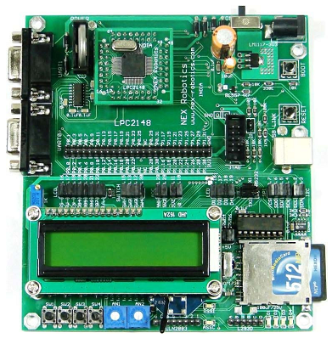
ARM 7 LPC2148

Slide 8
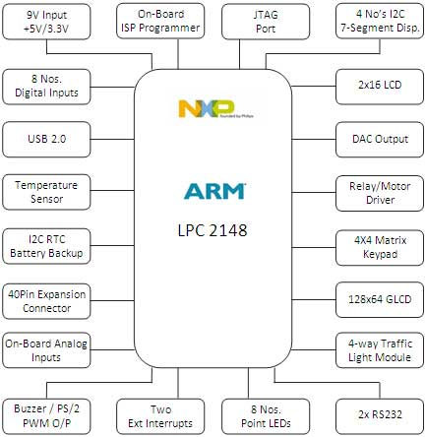
BLOCK DIAGRAM OF ARM 7 LPC2148

Slide 9
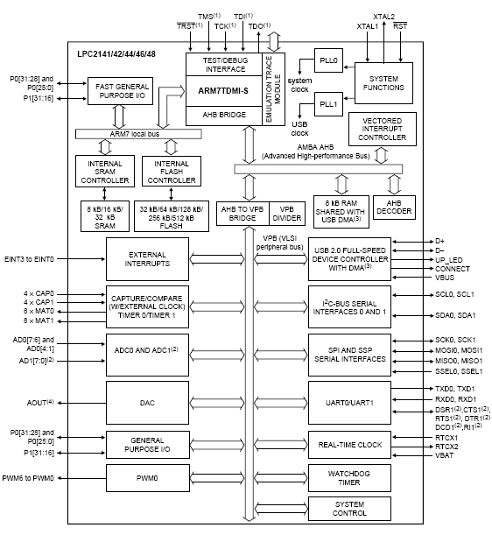
BLOCK DIAGRAM OF ARM 7 LPC2148

Slide 10
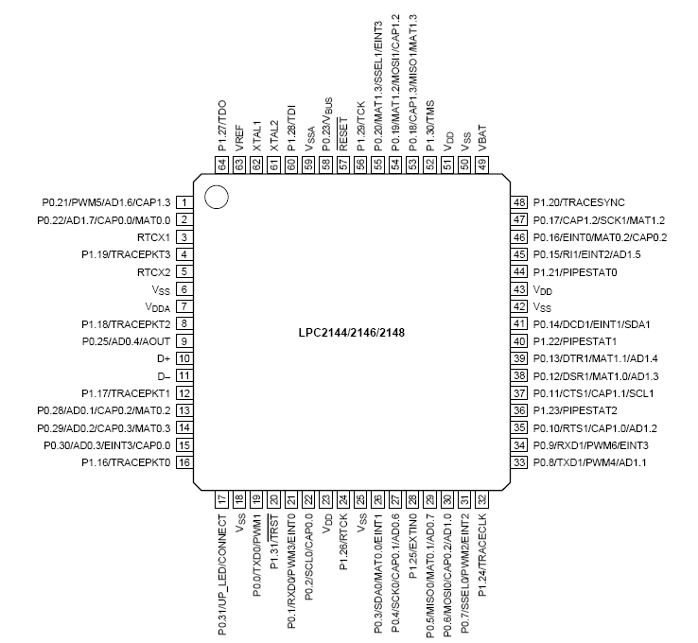
Pin Diagram

Slide 11
GSM MODULE
GSM Definition
-- GSM stands for Global System for Mobile Communications.
-- One of the leading digital cellular systems.
-- GSM was first introduced in 1991and as of the end of 1997;
GSM service was available in more than 100 countries and has
become the de standard in Europe and Asia.
-- GSM uses narrowband TDMA, which allows eight simultaneous
calls on the same radio frequency.
GSM Types
-- Three types of GSM differ according to the frequency band used in
each one and the number of ARFCNs;
1. GSM : Use frequencies between 890-915 MHz UL and 935-
960 MHz DL (Band of 25 MHz) with 124 ARFCNs.

Slide 12
2. EGSM : Use frequencies between 880-915 MHz UL and 925-960
MHz DL (Band of 35 MHz) with 174 ARFCNs.
DCS 1800 :Use frequencies between 1710-1785 MHz UL and 1805-
1880 MHz DL (Band of 75 MHz) with 374 ARFCNs.
-- Where ARFCN (Absolute Radio Frequency Channel Number) is a pair of frequencies, one to transmit (Up Link ) and one to receive (Down Link).
GSM Features
-- Compatibility that we can use the same mobile to make calls in
several countries.
-- Noise Robust such that digital GSM is better than analog
because it suffer from noise therefore using digital will reduce
the noise interference.
-- Flexibility and increased capacity due to equipment is smaller
in size.

Slide 13
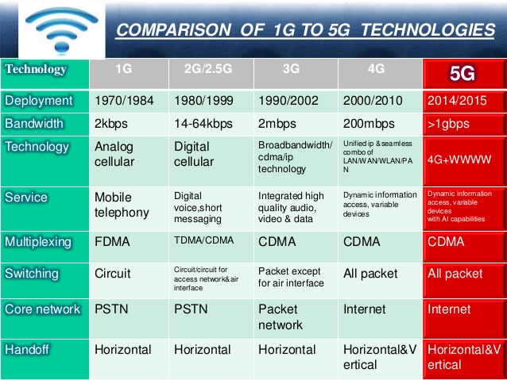

Slide 14
Fire Sensor
Introduction
-- Fire Sensor is also known has Flame Sensor Module.
-- This module is sensitive to the flame and radiation.
-- It also can detect ordinary light source in the range of a wavelength
760nm-1100 nm.
-- The detection distance is up to 100 cm.
-- The Flame sensor can output digital or analog signal.
-- It can be used as a flame alarm or in fire fighting robots.
Description
-- Detects a flame or a light source of a wavelength in the range of
760nm-1100 nm.
-- Detection distance: 20cm (4.8V) ~ 100cm (1V).
-- Detection angle about 60 degrees, it is sensitive to the flame spectrum.
-- Comparator chip LM393 makes module readings stable.
-- Adjustable detection range.
-- Operating voltage 3.3V-5V.
-- Digital and Analog Output
1. DO digital switch outputs (0 and 1)
2. AO analog voltage output
-- Power indicator and digital switch output indicator.

Slide 15
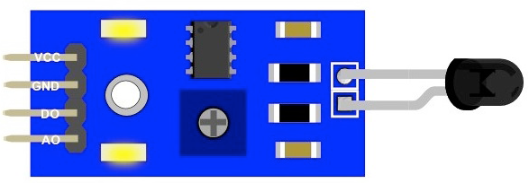
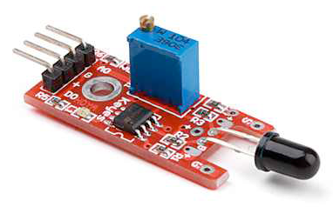

Slide 16
IR Sensor
What is IR Sensor?
-- IR sensor stands for infrared sensor.
-- An infrared sensor is an electronic device, that emits in order to sense
some aspects of the surroundings.
-- An IR Sensor can measure the heat of an object as well as detects the
motion.
-- These types of sensors measures only infrared radiation, rather than
emitting it that is called as a passive IR sensor.
-- Usually in the infrared spectrum, all the objects radiate some form of
thermal radiations.
-- These types of radiations are invisible to our eyes, that can be detected by
an infrared sensor.
-- The emitter is simply an IR LED (Light Emitting Diode) and the detector
is simply an IR photodiode which is sensitive to IR light of the same
wavelength as that emitted by the IR LED.
-- When IR light falls on the photodiode, The resistances and these output
voltages, change in proportion to the magnitude of the IR light received.

Slide 17
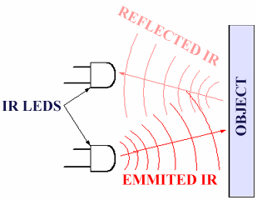

Slide 18
LCD Display
Introduction of LCD Display
-- LCD stands for Liquid Crystal Display.
-- Mostly used for Display of Message.
-- Highly user interactive.
-- We are using 16x2 character LCD.
-- 16x2 LCD means max 16 characters per line can be displayed and
there are 2 lines.
-- Single character is displayed in 5x7 pixel matrix.
Features of LCD Display
-- 5 x 8 dots with cursor.
-- Built in controller (KS 0066 or Equivalent).
-- + 5V power supply (Also available for + 3V).
-- 1/16 duty cycle.
-- B/L to be driven by pin 1, pin 2 or pin 15, pin 16 or A.K (LED).
-- N.V. optional for + 3V power supply.

Slide 19
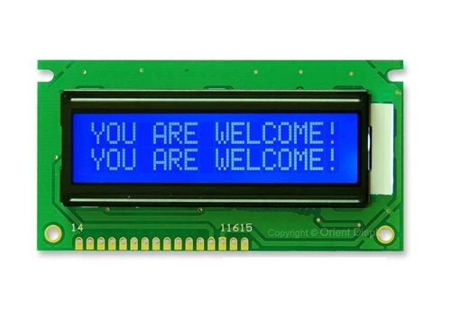

Slide 20
Buzzer
-- The buzzer is an output transducers converting electrical energy to
sound.
-- A buzzer is a signalling device, usually electronic, typically used in
automobiles, household appliances, industrial appliances.
-- They contain an internal oscillator to produce the sound which is set
at about 400Hz for buzzers.
-- Buzzers have a voltage rating but it is only approximate, for example
6V and 12V buzzers can be used with a 9V supply. Their typical
current is about 25mA.
-- Buzzers must be connected the right way round, their red lead is
positive (+).
What is Buzzer?

Slide 21
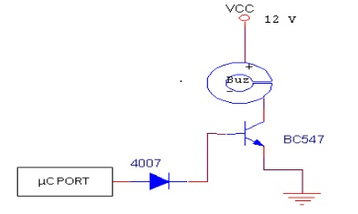
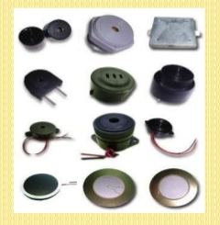

Slide 22
Software's Used
Keiluv4 IDE Tool
uc Flash USB
Keiluv4 IDE Tool
-- Keil was founded in 1982 by Gunter and Reinhard Keil; initially as a
German GbR.
-- In April 1985 the company was converted to Keil Electronic GmbH to
market add-on products for the development tools provided by many of the
Silicon vendors.
-- Keil implemented the first C compiler designed from the ground-up
specifically for the 8051 microcontroller.
-- Keil provides a broad range of development tools like ANSI C compiler,
macro assemblers, debuggers and simulators, linkers, IDE, library
managers, real-time operating systems and evaluation boards for Intel
8051, Intel MCS-251, ARM, andXC16x/C16x/ST10families.

Slide 23
uc Flash USB
-- The uc Flash USB Programmer is an affordable, reliable, and fast
programmer for MCS51/AVR Microcontrollers and 24Cxx I2C EEPROMs.
-- This uc Flash USB tool is used to dump the code into a device.
-- The programmer is designed to operate with the Intel Pentium-based IBM-
compatible desktop computers.
-- The menu-driven software interface makes it easy to operate.
Hardware Features
-- Single 40 Pin ZIF for 8 to 40 Pin Devices.
-- USB Interface.
-- Programmer firmware update through computer.
-- ISP programming supported.
Software Features
-- Works on Win Xp Operating System.
-- User-friendly interfaces with pull-down menus, pop-up dialogue box and help.
-- Device insertion test.
-- Support all operations, such as read, blank check, erase, program,
secure, & verify.

Slide 24
-- Easy to use integrated HEX Editor on main software window.
-- Supports Intel (linear & segmented) HEX (INHX8M).
-- Auto Batch Program function for faster programming i.e. Mass
Production mode.
-- Automatic device identification before programming.
-- Support for programming only a selected memory in the microcontroller
e.g. Data memory or Fuse Bits.

Slide 25
Necessity of technology
-- By using IR Sensor we are going to identify the obstacle to change the path or direction.
-- By using FIRE Sensor we are going to identify the fire and immediately message is forwarded to corresponded phone.
-- The IR Sensor and FIRE Sensor are controlled by the LPC 2148 MC.
-- Where all parameters can be send to a mobile in terms of SMS with the
help of GSM module.
-- We can track the vehicle or monitoring the vehicle by using GPS.

Slide 26
Design
POWER SUPPLY
LPC 2148
LCD
Vibration sensor
MOTOR DRIVER
DC MOTOR
Alcohol sensor
MAX232
GSM
FIRE sensor
MAX232
GPS
IR sensor
BUZZER

Slide 27
Functionality
-- GSM Module is connected to LPC 2148 MC .
-- The output of IR Sensor and FIRE Sensor are controlled by the help of LPC 2148 MC. Where the parameters are displayed on LCD.
-- The parameters can be send to the correspondent i.e, to a mobile.

Slide 28
PURPOSE
-- The purpose of the project is to know the vehicle theft by vibrating and anti
accident system and to detect fire using fire sensor and buzzer and SMS alert
on detection of fire.

Slide 29
Advantages
-- It is highly secured.
-- It is used in real time applications.
-- Its cost is less.
-- It is reliable for long period of time.
-- It can easily handle.
-- It saves energy by activating and deactivating devices. When the
device is idle stage.
-- It is versatility. Which is to adapt many different situations.
-- It is portability.

Slide 30
Applications
-- It is used for security .
-- It is used in vehicle monitoring by the vehicle correspond at all the
time by the help of GSM and tracking using GPS.

Slide 31
Conclusions
-- Vehicle to Vehicle Safety Device is a device indulge with the recent technology
and includes the methodology based on the combination of GPS, GSM and
many other modules by the help of which immediate support can be provided
to anyone in need of it.
-- It is used for security .
-- It is used in vehicle monitoring by the vehicle correspond at all the time by the
help of GSM .

Slide 32
Future Scope
-- This system can be further implemented using active GSM and GPS
which can be detected easily by the IR Sensor and FIRE Sensor
within a minimum range and to improve driver’s attention.
-- Further in case if the driver attends phone calls during the motion
of the vehicle an alert notification to the server can be provided.

Slide 33


